Slide 1
Instacart Market Basket Analysis
SANTHOSH S
BATCH : DMT6

Slide 2
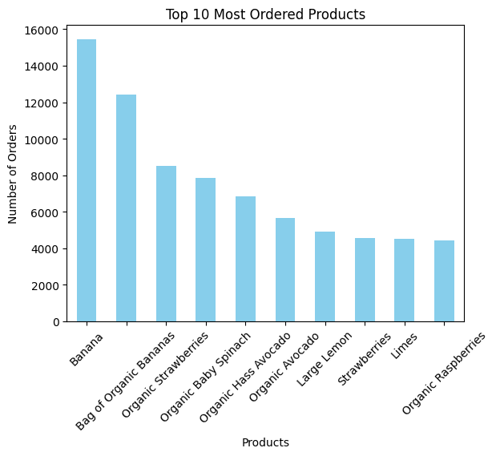
TOP 10 REORDER PRODUCT
1. Customer Behavior Patterns
﻿At 14,136, Banana had the highest Count of reordered and was 236.57% higher than Organic Raspberries, which had the lowest Count of reordered at 4,200.﻿﻿ ﻿﻿ ﻿
﻿﻿ ﻿﻿Banana accounted for 19.52% of Count of reordered.﻿﻿ ﻿﻿
﻿﻿Across all 10 product_name, Count of reordered ranged from 4,200 to 14,136.﻿﻿ ﻿﻿ ﻿

Slide 3
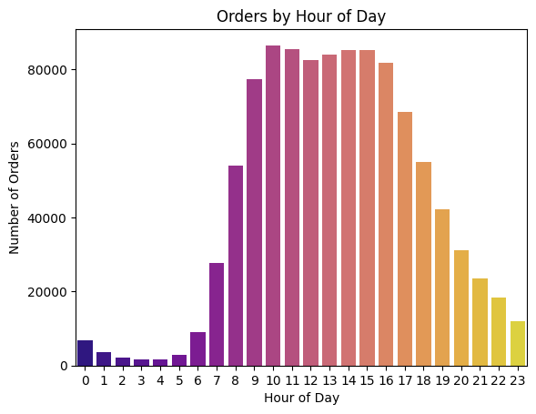
Order Timing: (Order Analysis)
Most orders are placed during weekends, with peak times around 10 AM to 3 PM.
Customers exhibit consistent ordering intervals, with many placing orders every 7 or 30 days.

Slide 4
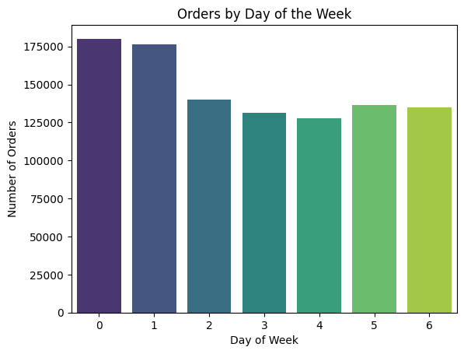
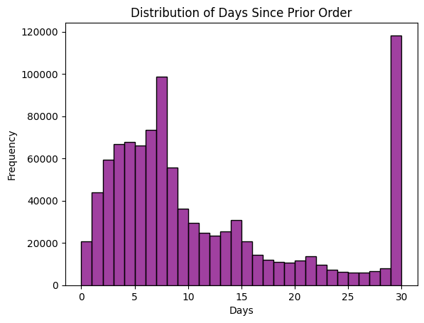

Slide 5
2. Product Popularity and Trends
Top Products:
Bananas, organic apples, and bottled water are among the most frequently purchased items.
Products in the produce department dominate sales, accounting for over 30% of total orders.
Reordering Trends:
Products in high-necessity categories (e.g., dairy, beverages) have a reorder rate of 70%+, reflecting their role as staples in customer baskets.
Low-Performing Products:
Specialty or niche items, such as gourmet foods or lesser-known brands, exhibit low order and reorder rates.

Slide 6
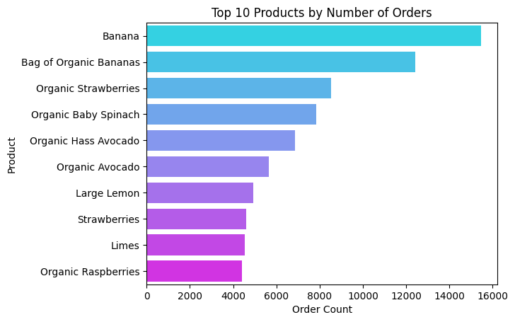

Slide 7
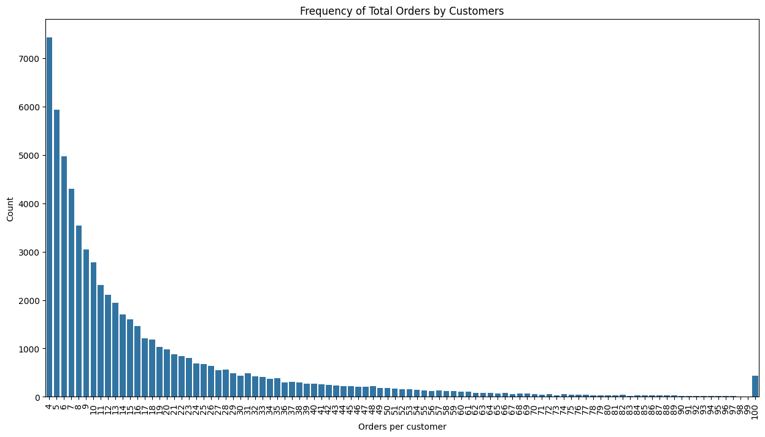

Slide 8
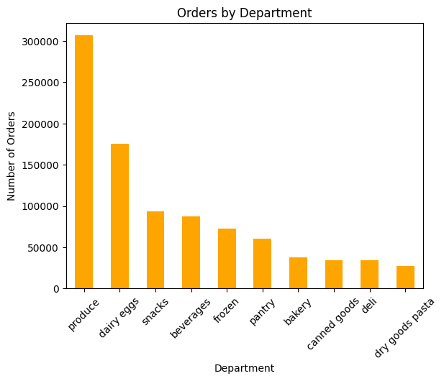
3. Anomalies and Patterns
Aisle and Department Insights:
High concentration of orders from a few aisles (e.g., fresh produce and dairy) while some aisles (e.g., personal care, baby products) have low engagement.

Slide 9
Actionable Recommendations
1. Improving Customer Retention
Personalized Marketing:
Leverage customer purchase history to send tailored product recommendations.
Offer discounts or loyalty rewards on frequently purchased items to incentivize repeat purchases.
Engage New Customers: Provide incentives (e.g., free delivery or discounts) for placing additional orders within their first month.
Recommend popular products like bananas or dairy staples in targeted emails to help customers build a habitual shopping pattern.

Slide 10
2. Increasing Product Sales
Cross-Selling Opportunities:
Bundle frequently reordered products with complementary items (e.g., pairing bread with butter or coffee with creamer).
Create promotional offers for underperforming aisles or products to boost visibility and sales.
3. Optimizing Order Fulfillment
Reduce Fulfillment Time: Group frequently ordered items in nearby storage locations to streamline picking and packing.

Slide 11
